Slide 1
Week 9 Numerical Simulation of Foams Presentation
By Tony Hau

Slide 2
Objective of this presentation section
To include some numerical simulations and relate them to my previous research

Slide 3




Main paper reference:
Motility-Driven Glass and Jamming Transitions in Biological Tissues https://journals.aps.org/prx/abstract/10.1103/PhysRevX.6.021011
2. SAMoS Tutorial
All framerates used in videos included in this ppt are 15.

Slide 4
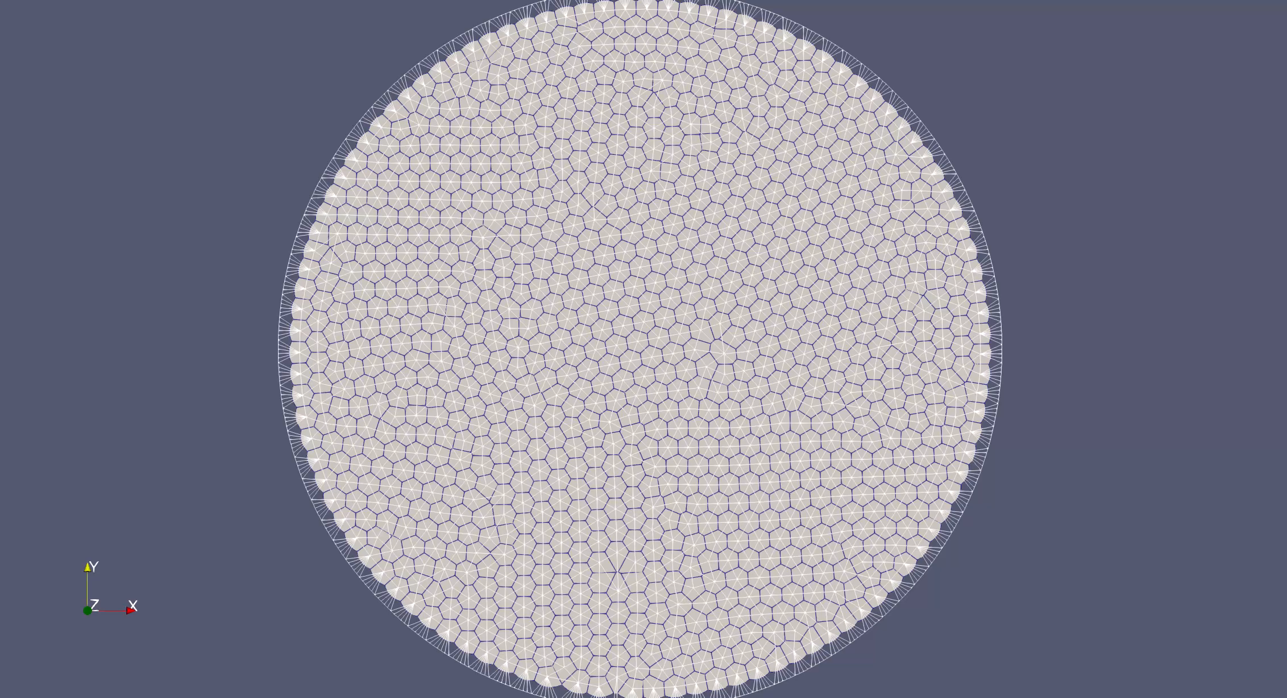
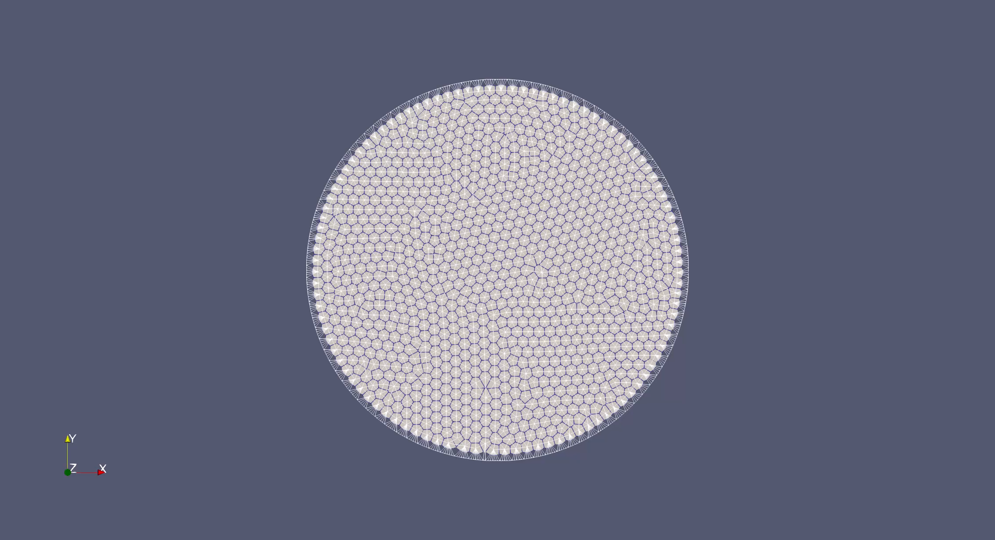
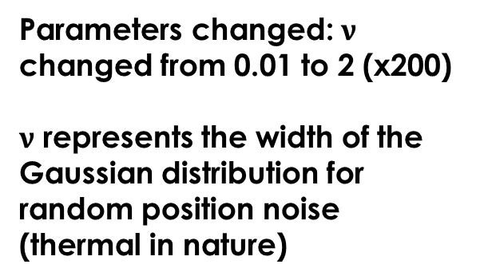
Experiment 1
Parameters changed: $ν$ changed from 0.01 to 2 (x200)
$ν$ represents the width of the Gaussian distribution for random position noise (thermal in nature)
Experimental result
Control

Slide 5
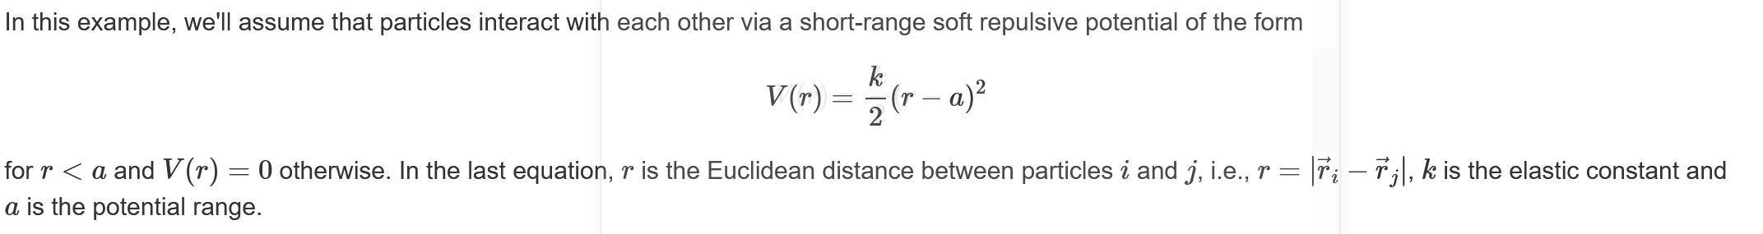
Experiment 2
Parameters changed: K(spring constant) of repulsive potential
changed from 10 to 50

Slide 6
Experiment 2
Experimental result
Control
No observable change

Slide 7
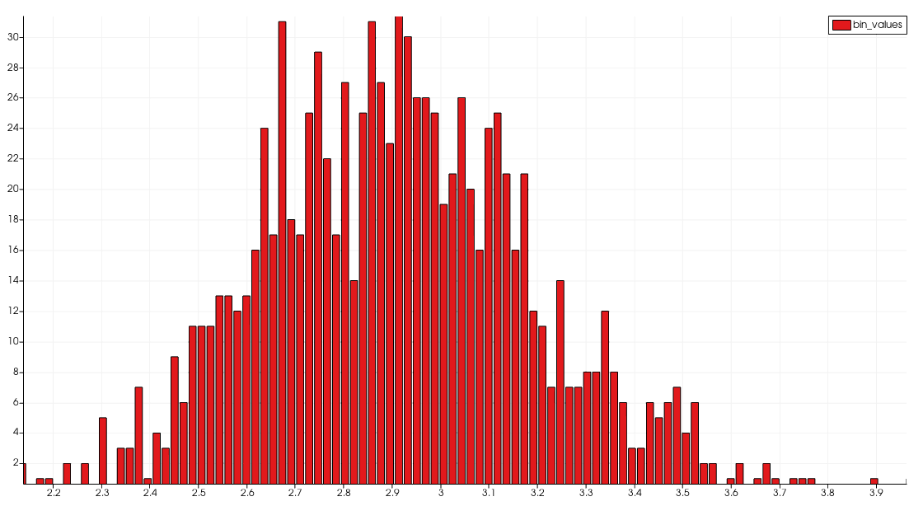
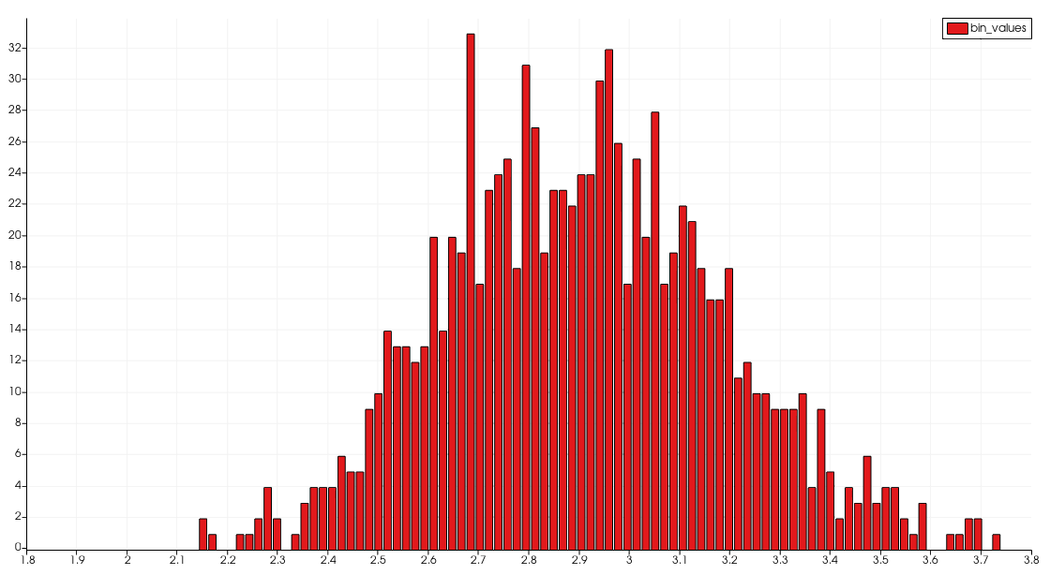
Experiment 2
SD=0.532
Mean=3.05
Experimental area distribution at frame 14
SD=0.537
Mean=3.05
Control area distribution at frame 14
No observable change

Slide 8
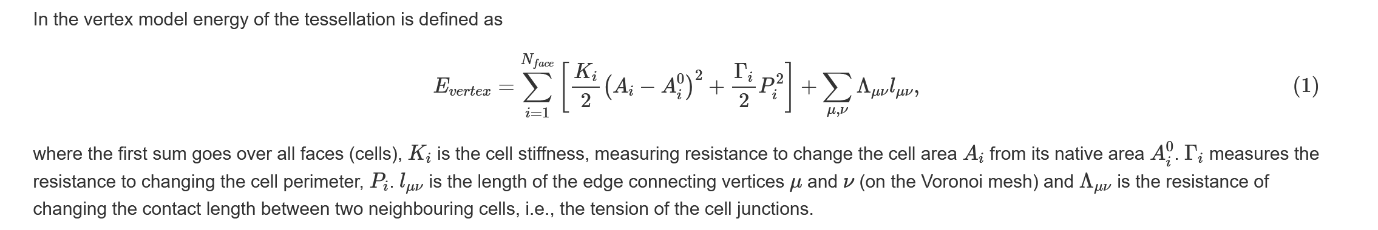
Experiment 3
Target area (native area) changed from 3.18 to 15.9 (x5)

Slide 9
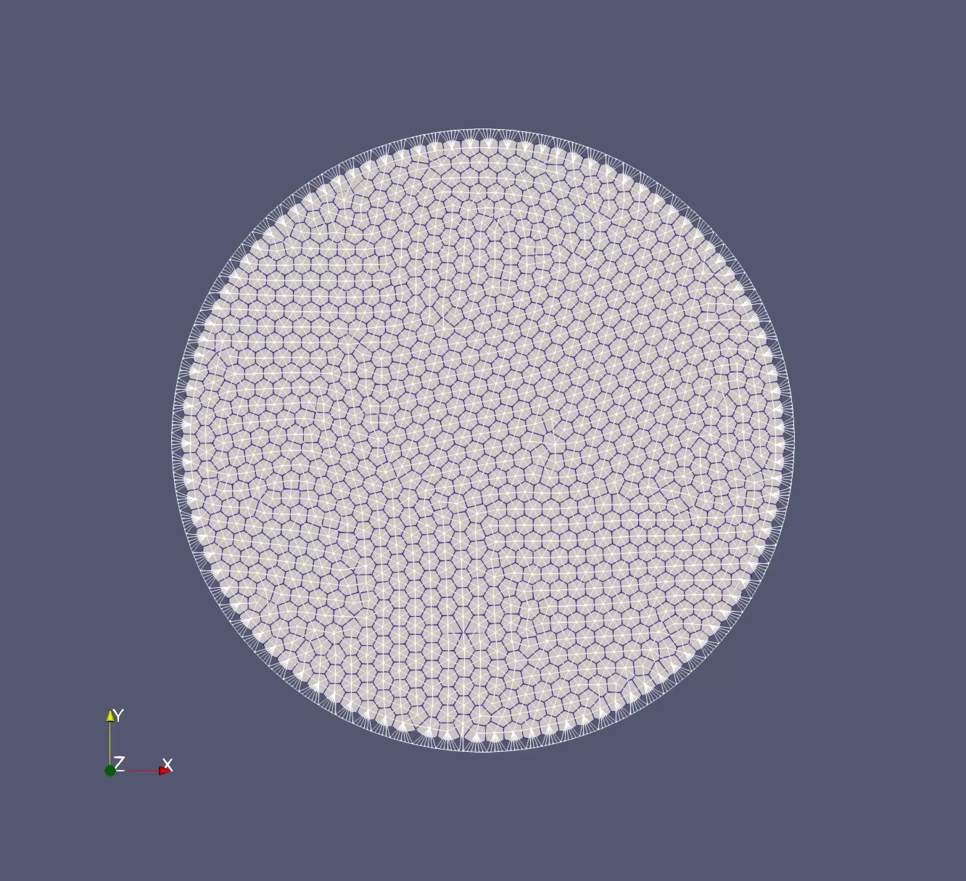
Experiment 3
Experimental result
Control
Slightly more sluggish

Slide 10
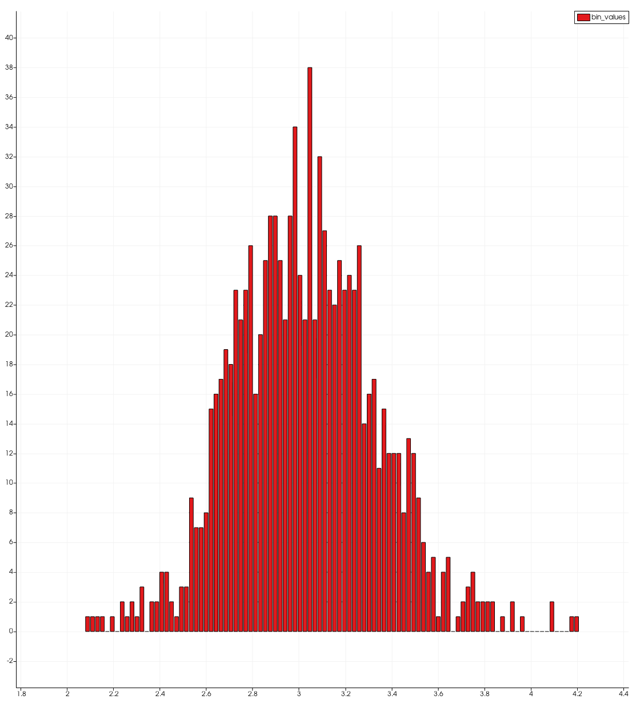
Experiment 3
SD=0.532
Mean=3.05
Experimental area distribution at frame 14
SD=0.617
Mean=3.14
Control area distribution at frame 14
Slightly more spread out

Slide 11
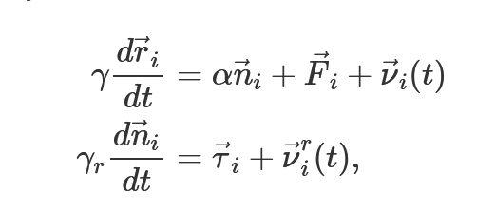
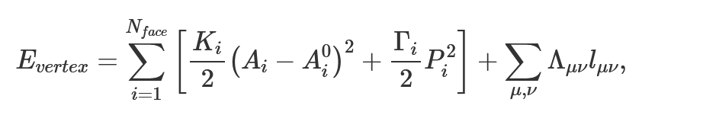
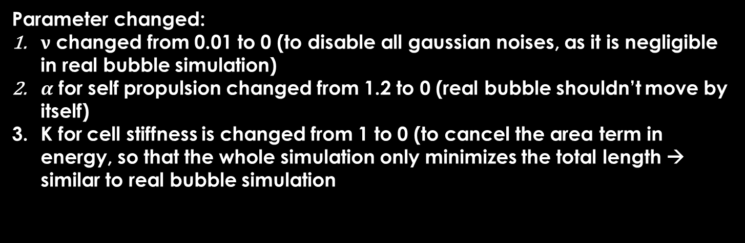
Experiment 4
Frictional force proportional to velocity
Parameter changed:
$ν$ changed from 0.01 to 0 (to disable all gaussian noises, as it is negligible in real bubble simulation)
$α$ for self propulsion changed from 1.2 to 0 (real bubble shouldn’t move by itself)
K for cell stiffness is changed from 1 to 0 (to cancel the area term in energy, so that the whole simulation only minimizes the total length → similar to real bubble simulation
Cohesive force exerted by neighbouring cells
Note: I tried to lower the K parameter for repulsion between cells, the programme crashes. It is reasonable because two bubbles should press against each other when they are too closed

Slide 12
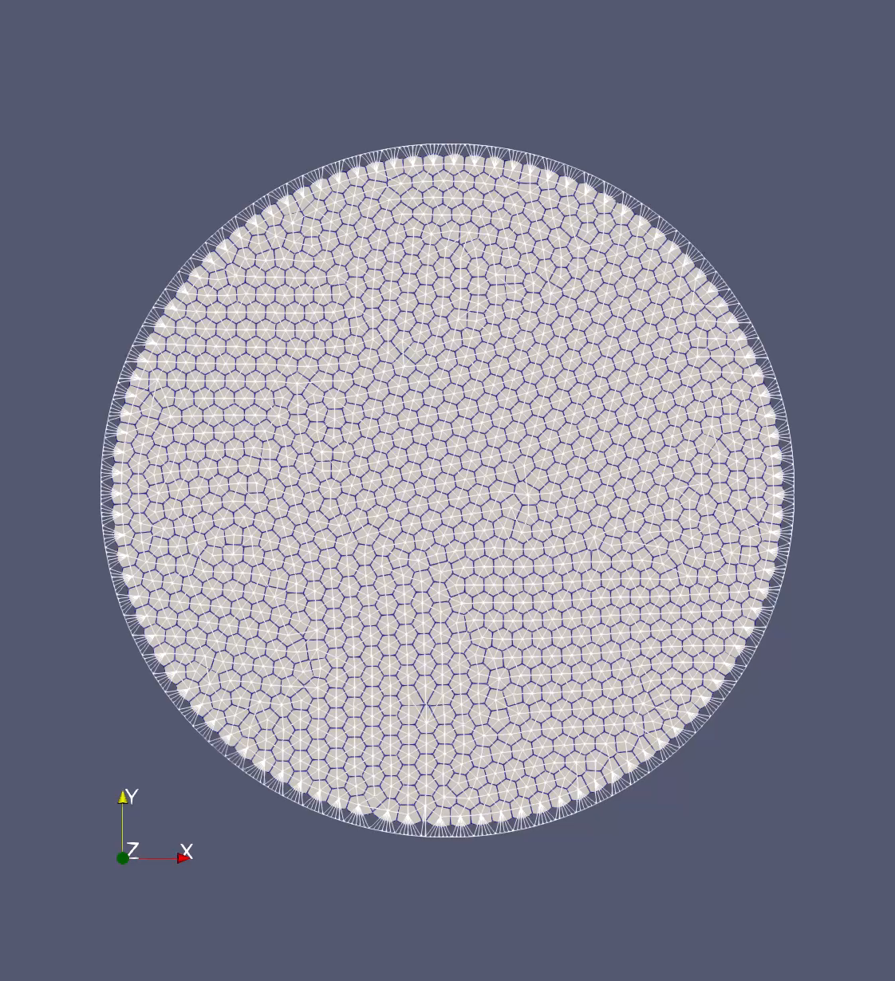
Experiment 4
Framerate = 1

Slide 13
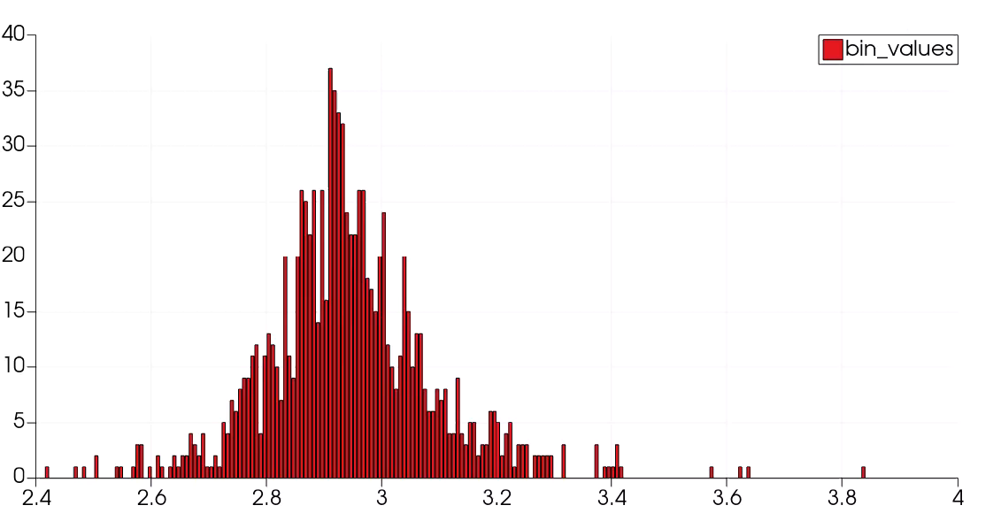
Experiment 4
Area distribution, Framerate = 1
Observation: The distribution of area is a gaussian, but the standard deviation is very small; Peak at mean around 2.9(native area = 3.18) the area mean decreases from 2.94 to 2.91 and then fluctuates around this value. SD is around 0.40the min value and max value fluctuates around 2.2 and 3.6 respectively

